Slide 1
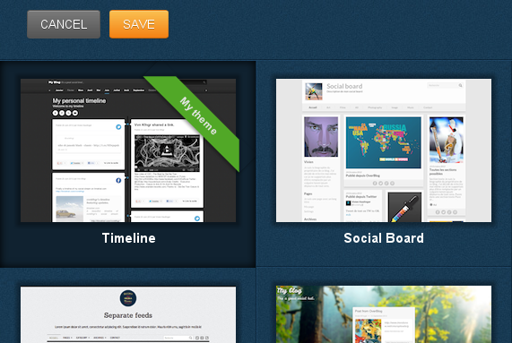
Pimp your blog!
Choose your theme
Modify it

Slide 2
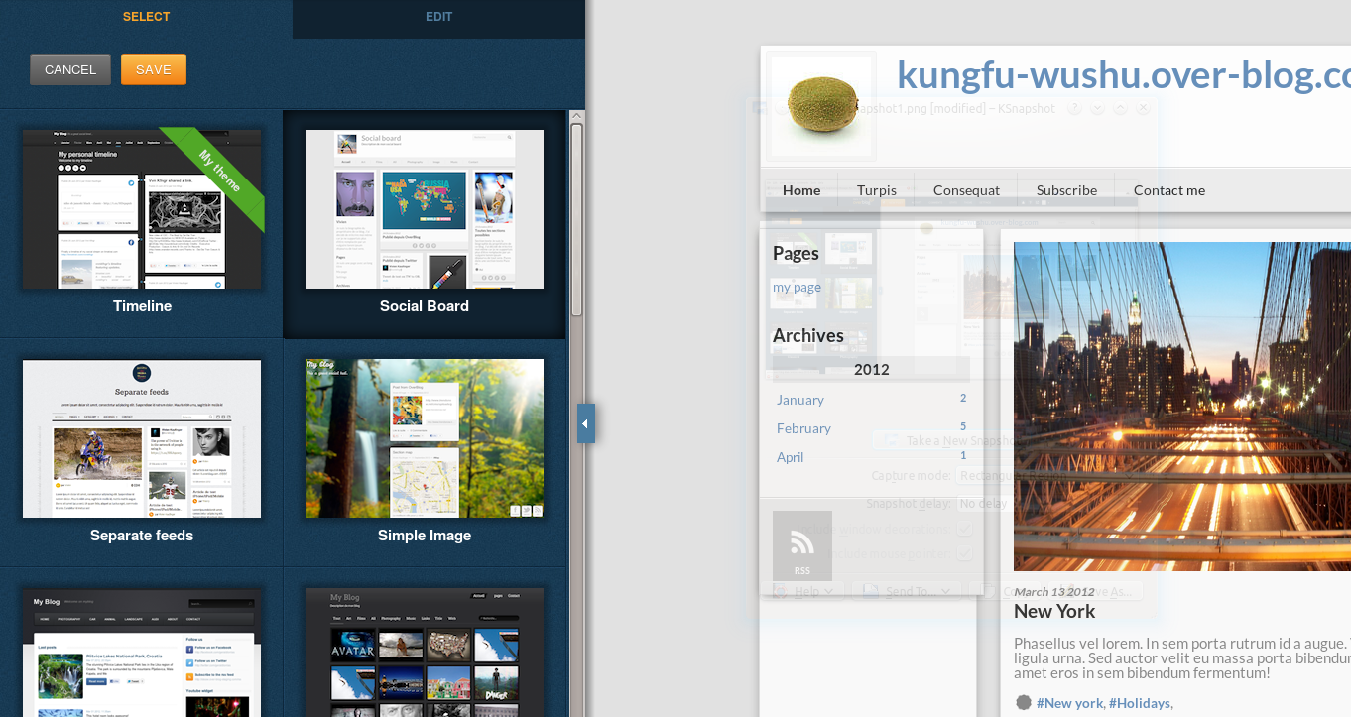
Pimp your blog!
Preview it
Apply it

